Slide 2
Posiflex India Group

Slide 3
Posiflex India Group
Quinta
S/w Development subsidiary of Posiflex India
Focused on building next generation Supply Chain / Retail & Store of Future Solutions
Team
Head of Engineering
Product Management Team
Software Architects, Engineers, Testers and Business Analysts
Notes:
Notes
Quinta is a subsidiary of Posiflex India and is focused on creating products for various verticals
There is a dedicated software team headed by an experienced Engineering Head with 20 years work experience and Product Managers
The team is set to grow from 10 currently to 40 in the 12 months
The success stories so far have been in the Industrial Domain where full-fledged WMS are implemented in Tier-1 Enterprise csutomers such as Siemens and Kirloskar
They are also building the Retail products that shall be covered in detail

Slide 4
Products
Retail
QIOSK (Kiosk Software)
QPoS (Entry Level Android Point of Sale)
Retail / Manufacturing
QWMS (Warehouse Management Software)
QWIP (Work in Progress)

Slide 5
Success Stories so far
Customer | Solution
Siemens | Warehouse Management Software + Mobile Devices Hardware
Kirloskar | Warehouse Management Software + Mobile Devices Hardware
Honeywell | RFID based Asset Management + RFID Readers/Tags
Flipkart (Walmart India E Commerce) | GPS based tracking of Last Mile Delivery Personnel > 3 Mn USD revenue for Hardware

Slide 6
QIOSK
Self Ordering and Self Checkout KIOSK Software

Slide 7
QIOSK Self-Ordering Use Cases
Food Courts in Shopping Malls, Corporate IT Parks
video
F&B Chains, Stand-alone Stores
video
Food-at-Gate in Airports
video

Slide 8
QIOSK Self-Checkout Use Cases
Fashion and Specialty Stores (RFID)
video
Supermarkets/Hypermarkets (Videos, Weight, Barcode)
video
Maintenance
video

Slide 9
QIOSK Architecture
KOT
Delivery
Print
QIOSK
Client
#1
QIOSK
SaaS Server
PoS 1
Pay
PoS 2
Print
QIOSK
Client
#2
PoS 3
Pay
Reports
DB
BI Reports

Slide 10
Standard
QIOSK Core Features
Advanced
Multiple Accounts/Tenants
Multiple PoS Software Integrations
Multiple Payment Options
Advanced Reporting
Image Management
Vendor Management
Video Analytics to capture
User Demographics
Customer Feedback
Promotion Personalization
Physically challenged friendly screen (Half-screen)

Slide 11
QIOSK Surround Features
High Availability SaaS Application
99% uptime
High configurability
Scalability
load balancing
Seamless Deployment
Migration to new version without impact
Seamless Integration
PoS, Payments
Modular Pricing
Pay for only what is consumed at a Feature level

Slide 12
QIOSK Self-Check Out Case Study

Slide 13
QPoS
Point-Of-Sale Software

Slide 14
Future of Hardware Business?
Margins under pressure from Me-Too brands/low cost Android Hardware
India Initiative – SaaS based PoS software offering – QPoS
One-App for all verticals and any Posiflex Android devices
Available for global market by end of Q4 2019

Slide 15
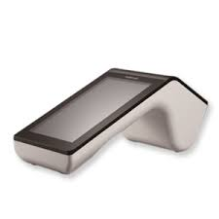
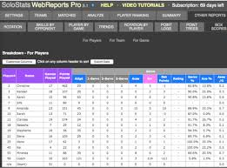
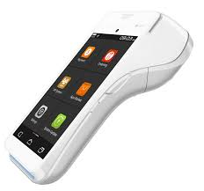
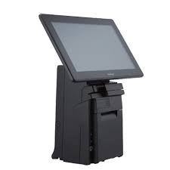
QPoS Architecture
Web Admin and Reports
QPOS
SaaS Cloud Server
WT3007
PAX A920
Cloud POS
HS3114
BI Reports
Reports
DB

Slide 16
QPoS Cloud
QPoS Cloud Server Capabilities
Availability
Scalability
Configurable
Expandability
Extensibility
Multi Tenant
Cloud SaaS
QPOS Cloud Server
Asia
Europe
QPOS Clients
QPOS Clients

Slide 17
QPoS Modules
PoS Module
Cloud Server
Merchant App
CRM & Loyalty

Slide 18
QPoS Core Features
Standard Features
Item Management
Category Management
Data Import/Export
Combo Kit Management
Billing Module
Reporting Module
Backup Module
Advanced Features
Cloud subscription
Barcode Scanning and Printing
Advertisement Management
Promotions Management
Android Remote Management
Biometric attendance Management
Online Food Ordering
Second display screen

Slide 19
Target Verticals
Retail
Supermarket & Groceries
Pharma and Healthcare
Electrical and Electronics
Lifestyle and Fashion
Specialized Retail
Restaurant
QSR
Restaurant & Bar
Bakery & Confectionery
Sweet Shop
Ice-cream parlours
Food Trucks
Food Courts

Slide 20
QPoS Product Video

Slide 21
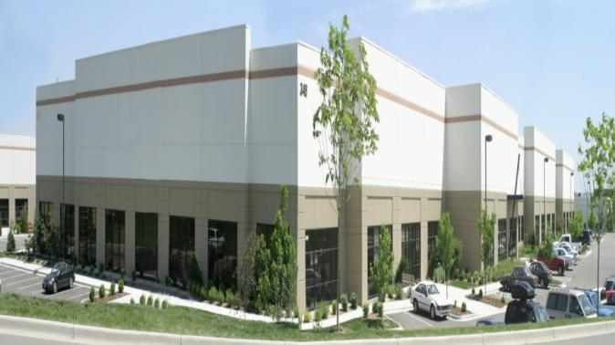
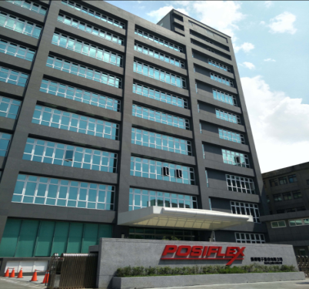
Thank You!
www.posiflex.com

